Slide 1
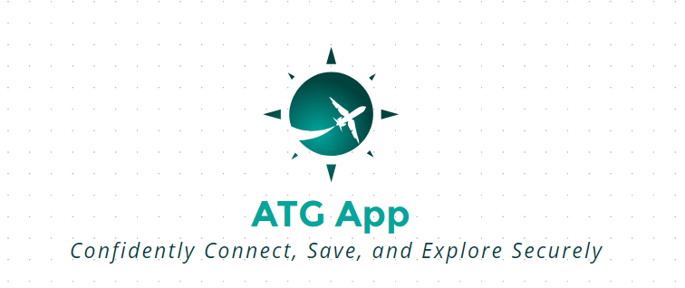
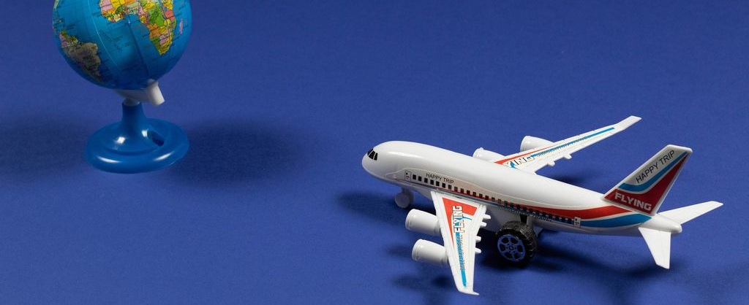
Around the Globe App
Section 1
University Of New Brunswick - MBA
This Photo by Unknown Author is licensed under CC BY

Slide 2
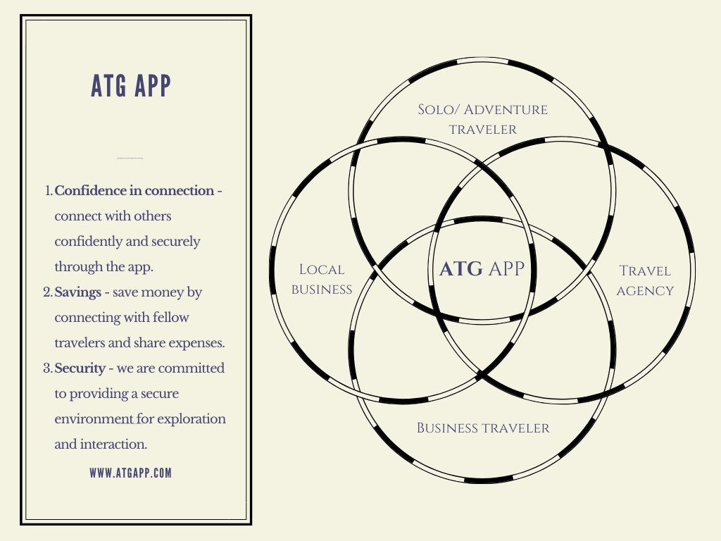
INTRODUCTION

Slide 3


Target Customer - Solo Travelers
Persona: Solo traveler Sarah values safety and shared travel interests.
Market Size and Trend: Millions of solo travelers globally, with a growing trend among young people who value independence and experiences.
Pain Point and Opportunity
Safety concerns and difficulty finding compatible travel companions.
A secure and reliable platform to connect with like-minded travelers for shared experiences.
Why Now? Increasing independence and mobile connectivity make this an opportune moment for a companion finding app with enhanced safety and security.
Who pays? Economic Buyers: Solo travelers and travel agencies who value enhanced, safe, and community-oriented travel experiences.
User Feedback: Strong demand for features like user verification, rating and review system, in-app messaging, safe matching, itinerary sharing, and local experience based on interviews with solo travelers.

Slide 4



First 10 Target Customers
Individuals:
Sarah J. a frequent solo traveler
Alex B. an adventure seeker
Emily F. a budget-conscious traveler
Lee Min H. is a socially oriented traveler interested in meeting people from diverse cultures.
Businesses:
A travel agency specializing in solo trips.
A company organizing adventure travel for solo explorers.
A company focusing on secure travel arrangements.
Institutions:
Solo women: a community and resource for solo female travelers.
University: offering study abroad programs.
Retreats International: organizing business trips for solo business travelers.

Slide 5
Unique Selling Proposition (USP)
Value Propositions and Benefits
 | Short Term
S/N | Activity | Description | Focus
1 | Direct Sales | prospecting and customer acquisition for Adventure, budget conscious and social oriented Travellers through Internet Marketing such as Influencers Tourist | Demand Creation with target end customers
 | Medium Term
1 | Travel Agencies | Relationships with travel agencies to create new and existing accounts. | Expand market
2 | Value Added Resellers (VARs) | Target medium and small accounts in existing markets and expand into international markets | Grow market
 | Long Term
1 | Travel Agencies | Relationships with travel agencies to create new and existing accounts. | Expand market
2 | Web Sales and Direct Telemarketing | Commission based selling | Grow market
1. Consolidated Travel Booking Platform (QVP):
Book flights, hotels, events, transfers, and potentially other travel services (tours, activities) in one place to save time and effort. It helps to reduce the time a user spends booking a complete trip compared to using separate platforms.
2. Competitive Pricing & Deals (QVP):
Access exclusive deals and discounts on flights, hotels, and other travel services through partnerships with travel providers.
3. Curated Travel Experiences (QVP):
Discover and book unique events, activities, and local experiences based on user preferences and travel destinations partnerships with travel providers.
4. Personalized Travel Recommendations (QVP):
Personalized recommendations for flights, hotels, and experiences based on interests, travel style, and past booking history.
Specific region: Offering in-depth local knowledge, curated experiences, and partnerships
Innovation in travel booking: A unique booking feature or service streamlining the travel planning process, such as trip planning and augmented reality hotel previews.
Partnerships: Agencies Traveller
Specific niche: Target specific adventure travelers and eco-conscious tourists, and travellers are seeking all-in-one travel solutions.

Slide 6
FULL LIFE CYCLE USE CASE
Aware of need & to take an action
Find out about our APP
Analyze and evaluate options
Decision to download our APP
Sign in & user verification
Planning & connection
Experience sharing
Long term engagement
Log In
Input destination
Filter & suggest trip
Pay for trip
Input travel date
Connect with fellow travellers

Slide 7
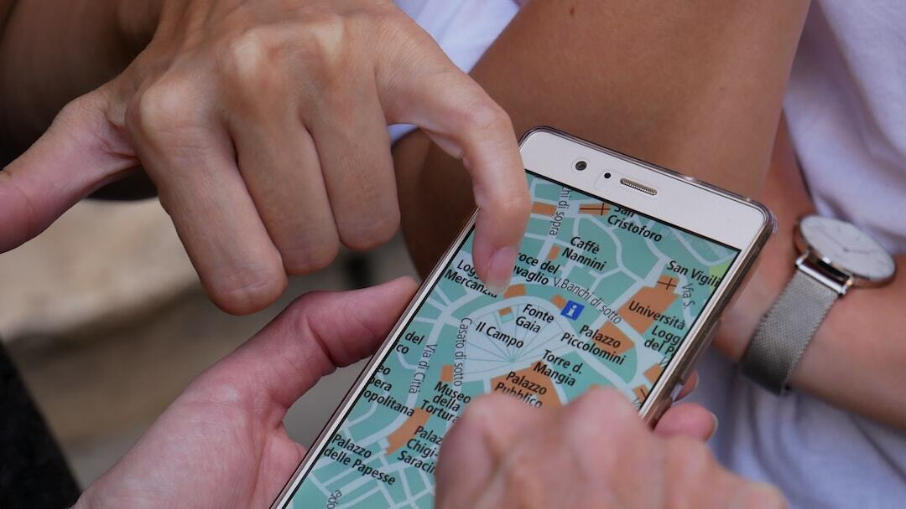
Go-to-Market Strategy: Acquisition Channels
Word of Mouth: Marketing through friends, families, colleagues, and classmates fosters organic growth.
Referrals with Incentives: Encouraging existing users to refer new ones by offering attractive incentives.
Partnerships: Collaborating with travel agents, tourist companies, and hotels to gain new customers.
Photo by Sebastian Hietsch on Unsplash

Slide 8
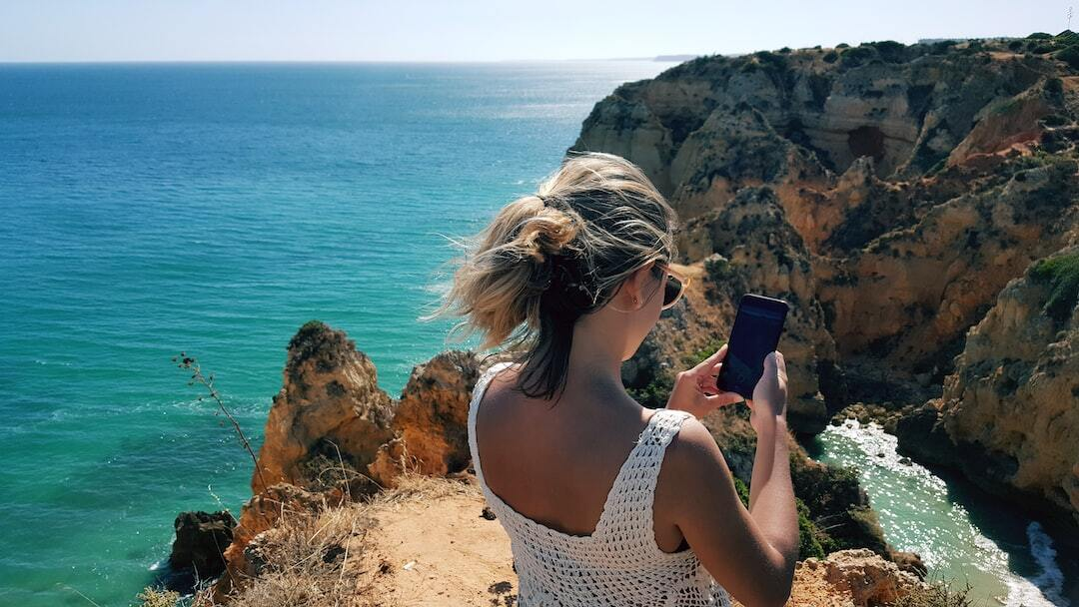
Creating and Fulfilling Demand
Curate Itineraries and Content: Develop targeted itineraries and content to meet specific needs of various personas.
Optimize App Visibility: Enhance app discoverability through strategic keyword optimization in app titles.
Collaborative Partnerships: Form alliances with travel agencies, hotels, airlines for exclusive deals, leveraging the app's safety features to build community trust.
Photo by Felipe Cotrim on Unsplash

Slide 9

COCA and Market Penetration
Initial COCA: High initial cost to acquire customers as we establish brand awareness and gain first users.
COCA Reduction Strategy: Expected decrease over time as the app gains traction and expands its user base, leading to lower marketing costs per customer.
Market Penetration Impact: Increased market penetration correlates with reduced COCA, enhancing profitability.
Photo by Kastriot Thaqi on Unsplash

Slide 10

Business Model and Revenue Streams
Diverse Revenue Sources: Revenue generated from booking fees, premium feature charges, advertisement fees from local businesses, and commissions from affiliate partnerships.
Advertisement and Commissions: Partnerships with local businesses and travel agencies enhance revenue through advertisements and commissions.
Premium Features: Charges for accessing premium app features add an additional revenue stream, attracting more engaged users.
Photo by Christina @ wocintechchat.com on Unsplash

Slide 11
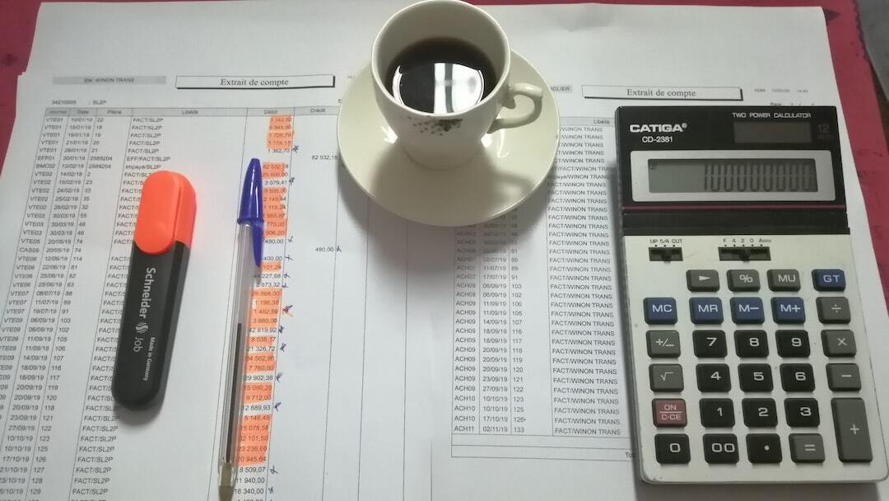
Pricing Assumptions and Financial Metrics
Average Booking Value: Estimated at $200 per user, influenced by the type of services booked (hotels, flights, tours).
User Engagement: Users open the app twice a week, with each session involving approximately 10 clicks.
Commission-Based Collaborations: Each travel agency partnership generates a 10% commission per booking, averaging 50 monthly bookings.
Photo by HAFIDA ABOUSALIH on Unsplash

Slide 12
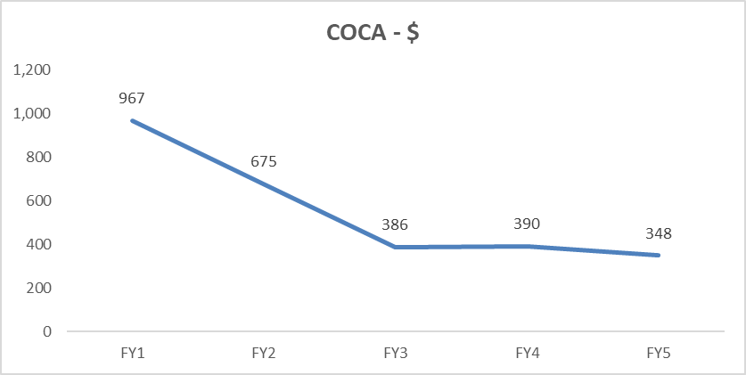
Financials

Slide 13
Key Milestone & Exist Strategy
Key Milestones driving financials
User Acquisition
User Retention and Engagement
Geographic Expansion
Strategic Partnerships and Alliance
Exist Strategy
Initial Public Offering (IPO)
Acquisition by a Larger Player
Merger with a Peer
Private Sale

Slide 14





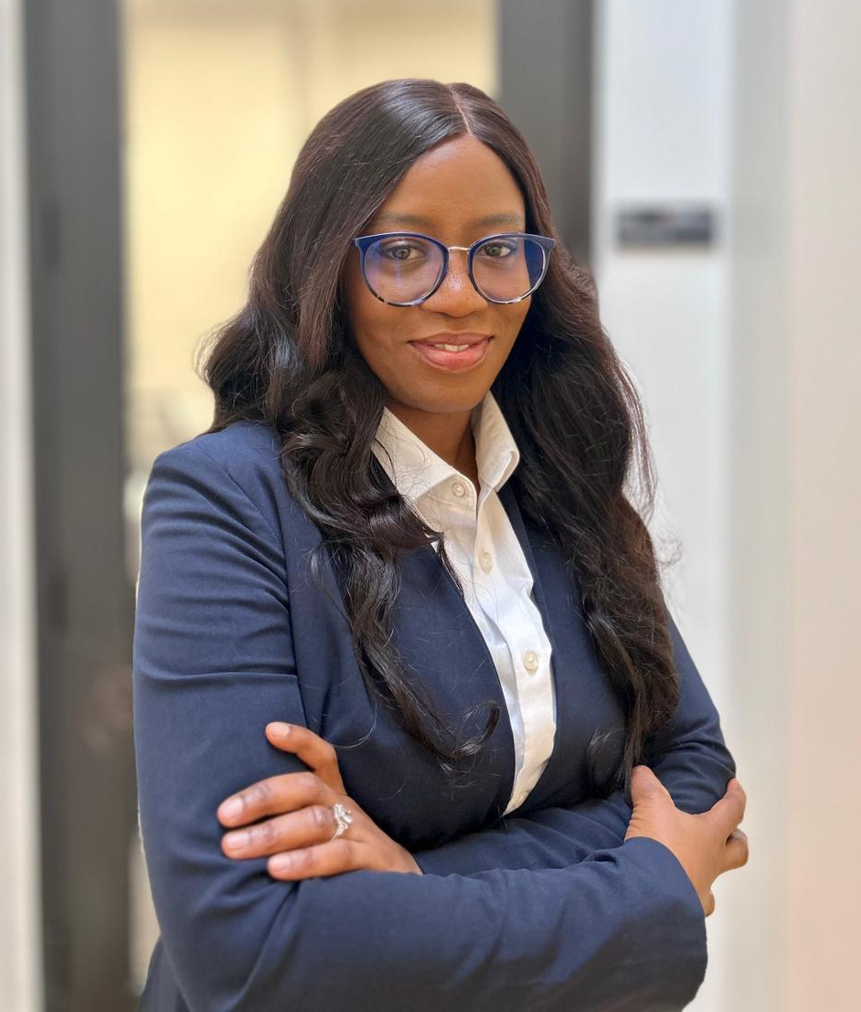
TEAM (Who we are, Roles and Qualifications)
Name - Udekwe Stella
Roles - Develop and implement marketing strategies to promote the app to target audiences, including solo travelers and travel enthusiasts
Qualifications – Degree in digital marketing and mass communication, knowledge of the travel market, proficiency in social media and content digital marketing.
Name – Muhammed Sillah
Roles - Manage purchasing goods and services needed for the app’s development and daily operations, ensuring cost efficiency and quality
Qualifications - Experience in procurement and supply chain management, negotiation skills, and knowledge of the relevant market for technology and services.
CMO
COO
Name – Adeboyejo Ayomide
Roles - Responsible for budget management, economic forecasting, and analyzing financial data
Qualifications - Degree in Finance and Accounting, proficiency with financial modeling, forecasting tools, and experience in budget management.
Name – Jamiu Abdulraheem
Roles – Develop and maintain the technical infrastructure of the app, including frontend and backend development
Qualifications - Proficiency in programming language & experience with mobile app development frameworks.
CFO
Software developer
Name – Elnaz Jahani
Roles - Provide support and assistance to app users, addressing any issues or queries
Qualifications - Strong communication skills, experience in customer service, and familiarity with troubleshooting common software issues.
Name – Gabriella Ade - Ayeni
Roles - Oversee the development and management of the app, ensuring it meets user needs and business objectives.
Qualifications - Experience in product management, and the travel industry with excellent project management skills.
CSO
CPM

Slide 15
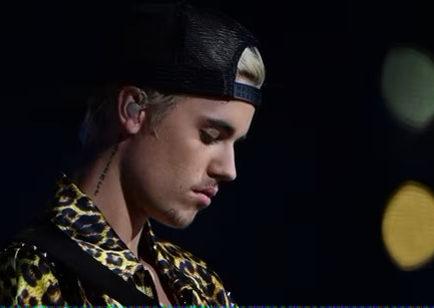
Team
Anticipated future addition to the team
Justin Bieber
As the ambassador would primarily enhance brand visibility and attract users through promotional campaigns and his extensive social media influence.

Slide 16
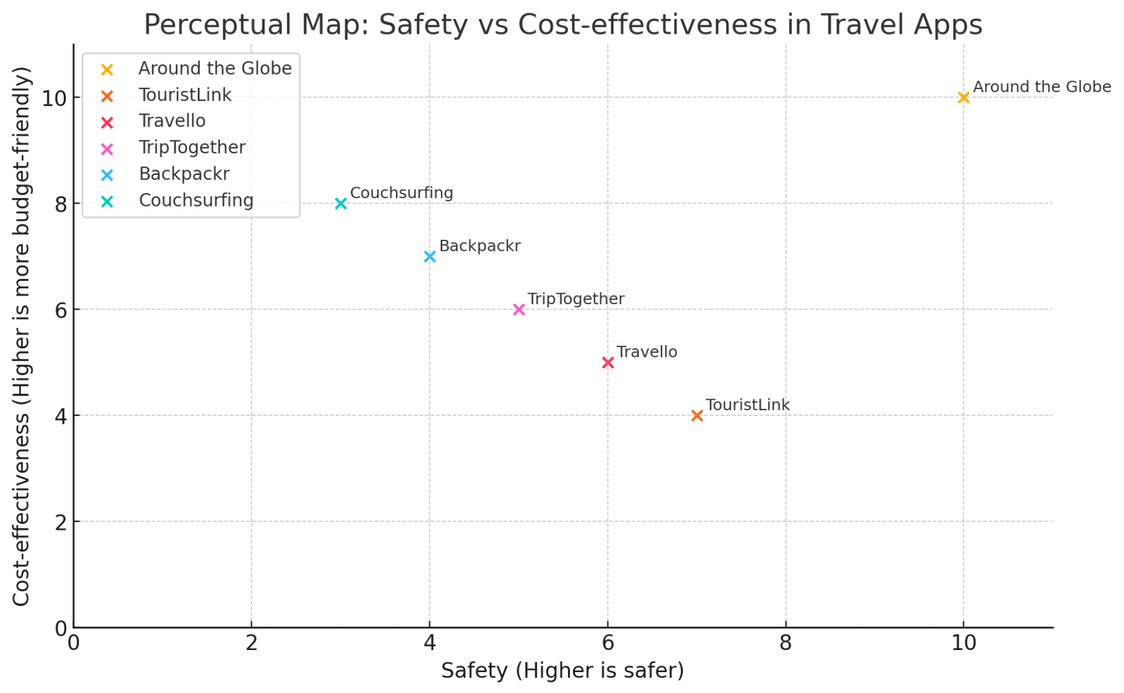
Competition
Sustainable Competitive Advantage
Around the Globe App’s unique combination of safety, savings, superior matching algorithm, and ease of use sets the app apart from alternatives, making it a compelling choice for travelers seeking connection, security, and affordability. It builds a loyal community with rewards, integrates seamlessly with other travel services, and consistently updates its features to enhance user experience and promote sustainable tourism.

Slide 17


Conclusion
Summary of Three Key Points
Connect: Seamlessly connect with fellow travelers heading to the same destination.
Save: Share expenses and maximize savings by traveling in groups.
Security: Travel confidently and securely with our safety features.
Call to Action
Investment: We are seeking $350,000 in seed funding to develop further and launch the Around the Globe app.
Possible Exits: Potential exits include acquisition by a larger travel company, strategic partnerships, or Initial Public Offer.
Returns: Equity appreciation, dividends, or acquisition premiums.
Our "Ask"
Join us on this exciting journey to revolutionize the way people travel and connect around the globe! Invest in our vision and be part of our success story.
This Photo by Unknown Author is licensed under CC BY

